Slide 1
Drug information
Here is where your presentation begins
By: Dr. Riffat Ibrahim Riffat

Slide 2
What is a Protocol ?
Gives detailed schedule of tests, procedures, medications, dosages, Sample size and length of the study.
Describes what types of people may participate in the trial (inclusion and exclusion criteria) .
Principal Investigator is responsible for assuring that the protocol is strictly followed for each participant

Slide 3
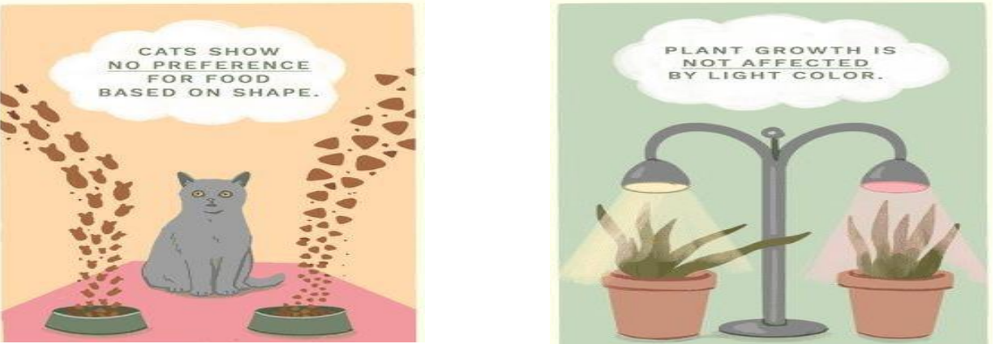
H0 Hypothesis:
Null Hypothesis Predicts that no differences between two variables.
So, in a clinical trial we proof the concept relying on the H0 hypothesis.

Slide 4
Precision & Power of the study
Error type 1 (Alpha) : affects precision of the clinical study. The possibility of error type 1 ( False positive) to occur is 5% So, The precision is 95% .
Error type 2 ( Beta ): affects power of the clinical study.
The possibility of error type 2 ( False negative ) to occur is 20%, So the power is 80% .

Slide 5
If the fact says that : there is no differences between the current & New drugs ( The fact supports H0 ) and your decision is : there is a difference between them , So your decision is False positive is an Error type 1 ( Alpha ) .
But if your decision is : there is no difference between them , so your decision is correct ( 1-α ) .If the fact says that: there is difference between current & New drugs, but your decision is : there is no difference between them , so your decision is False negative is an error type 2 (β).

Slide 6
Institutional Review Board (IRB)
Definition: A committee of specific composition at an affiliated fair, high school, or institution that reviews research plans involving human subjects to determine potential physical and/or psychological risk.

Slide 7
What is informed consent?
Informed consent means asking the data subject for permission before a process after explaining the activity, for what purpose their data will be used, and how it will be processed.

Slide 8
Participants must fulfill the following criteria:
Must give informed consent.
Should be representative of the population.
Should be qualified or eligible(Psychologically) for the trial

Slide 9
"Essential Elements of Informed Consent:
Research description
Risks
Benefits
Procedures
Alternatives
Confidentiality
Contacts
Voluntary participation and withdrawal"

Slide 10
Subject dropout and compliance
Not all subjects randomized in a clinical trial will complete the entire duration, at which time they are then termed a study dropout or stated to be lost to follow-up.
Reasons for discontinuing study participation :
  1-Lack of desire to continue.
  2-Subject relocation (i.e., moving to another city).
  3-Subject violating study protocol, side effects, and death.
  4-Not all subjects will be compliant with the therapy

Slide 11
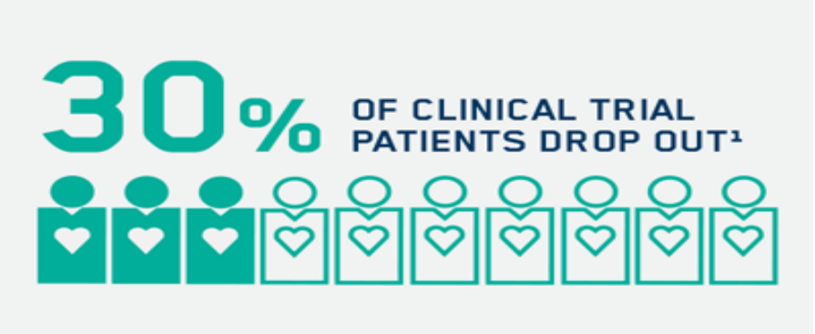

Slide 12
Clinical Outcomes
Definition: Medical events that occur as a result of disease or treatment
Examples:
  Pain Relief
  Cure of Infection

Slide 13
Types of outcomes
Primary Outcome: is the outcome of interest that has been set by the researcher at the beginning of the study.
Secondary Outcome: is the additional outcome that occurs during the study.

Slide 14
According to results comparing, can be classified studies in to:
Positive studies: a favorable result for the therapy understudy, are readily published.
Negative studies: a study that does not show favorable results from the new therapy) may not be published. These results may due to the existence of questionable data or poorly designed studies.

Slide 15
Evaluation of prepared RCT
Title
Abstract
Introduction
Method

Slide 16
Title
A title should be reflective of the work,unbiased, specific, and concise (i.e., usually ≤ 10 words)
  not too general or detailed.
  the title should not be phrased as a question
  randomized clinical trials should be identified in the title.

Slide 17
Blinding in Clinical Trials
An example for a biased study title:
  “Improved bronchodilation with levalbuterol compared with racemic albuterol in patients with asthma.”
suggested unbiased title for this trial is:
  “Comparison of levalbuterol and racemic albuterol bronchodilation in patients with asthma: a randomized clinical trial.”

Slide 18
Abstract:
Abstracts include information:
the article objective, methods, results, and conclusions. usually contain ≤500 words.
Types of abstracts:
  a. structured
  b. non-structured

Slide 19
Abstract:
Advantages of Structured abstracts :
  more informative
  easier to read
  generally preferred by readers.

Slide 20
Introduction
should be discussing the study rationale
clearly stated research purpose
should explain how the clinical trial will overcome the shortcomings of the prior research

Slide 21
Methods
Methods should include:
  The type of subjects enrolled
  The comparative therapy description
  Outcome measures
  Statistics.

Slide 22
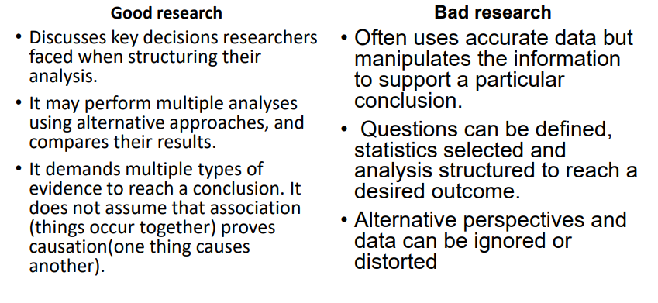

Slide 23
The investigators
Need to be properly trained and have active practice experience in the area of study.
The site where the clinical trial was conducted (have the resources to properly and completely perform the necessary study methods).
Persons involved with the study need to be ethical and responsible to protect patients enrolled in the study

